Slide 1
Renewable Energy Project
Spring 2023 Mechanical Engineering Capstone
Northern Arizona University
Presented by:
Michael Horn, Garrett Cornelius, Issac Granados, Nicholis Santana

Slide 2
Project Description
Background:
Private party off grid cabin to be constructed by Winiecki family
Design and Install Hybrid Solar System
Site location established
APS power will be connected
Project appraised for $90K
Project Goals:
Analyze solar photovoltaic systems for off grid application
Model estimated energy load / consumption of the Winiecki off grid cabin
Test energy demands of cabin
Optimize solar system for maximum efficiency
Implement and install selected solar design
Michael Horn
04/26/23
Renewable Energy

Slide 3
Project Scope Changes
Delayed House Construction
Permitting still underway
Construction has NOT begun
Team not legally able to begin PV solar system assembly
Purchase and Installation delayed until further notice
Shift towards analytical based project
Team must supplement assembly process
Analytical deliverables will replace hardware deliverables
System design, energy modeling, structural analysis, spot testing of individual components, mock permitting

Slide 4
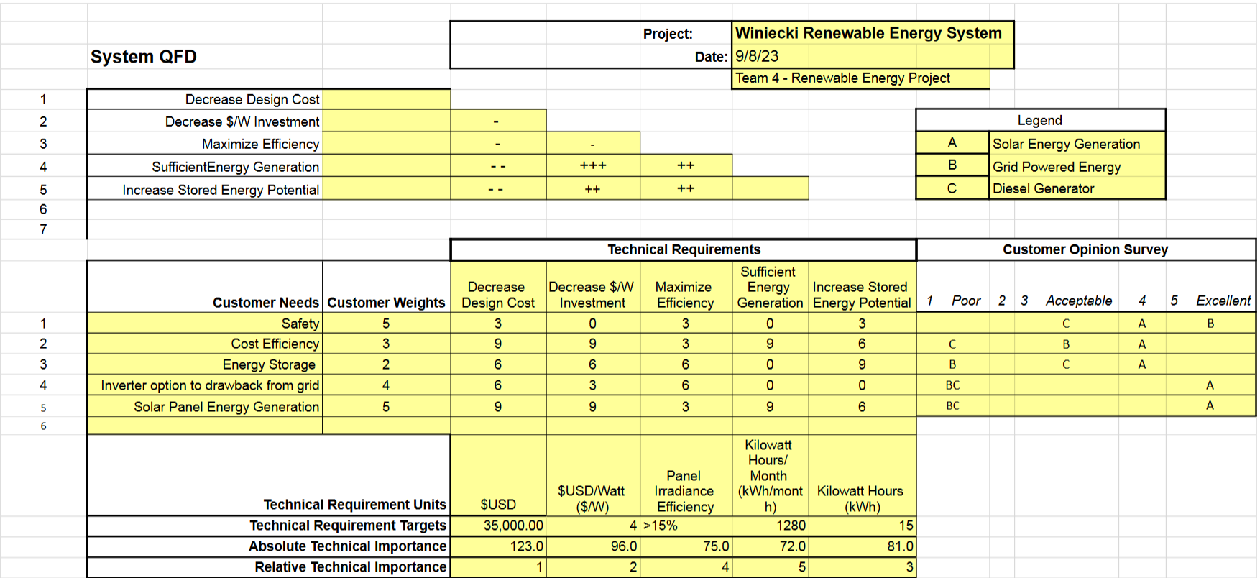
QFD

Slide 5
Simplified Customer Needs
Budget : $35,000
Self Sustaining Production
1 Day Emergency Battery Storage
0 Backfeed Grid Tied Connection

Slide 6
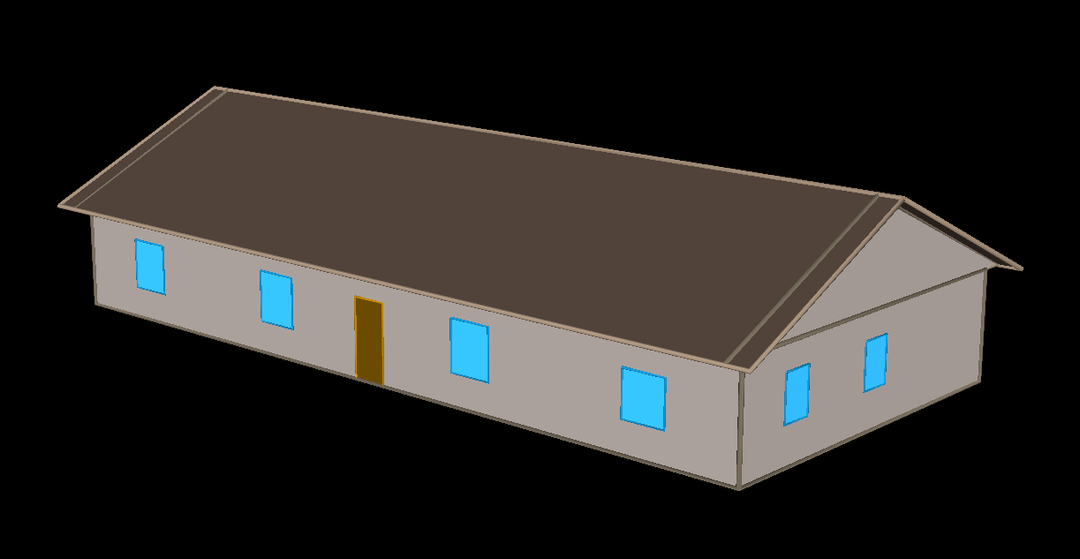

Whole Building Energy Modeling
Purpose: Simulate electrical demand for the home to define system scale
eQuest: Department of Energy’s simulation tool powered by the EnergyPlus simulation engine

Slide 7
Energy Model Results
2 Output Simulations to benchmark design and demonstrate user impact
Expected Demand Simulation
High Demand Simulation

Slide 8
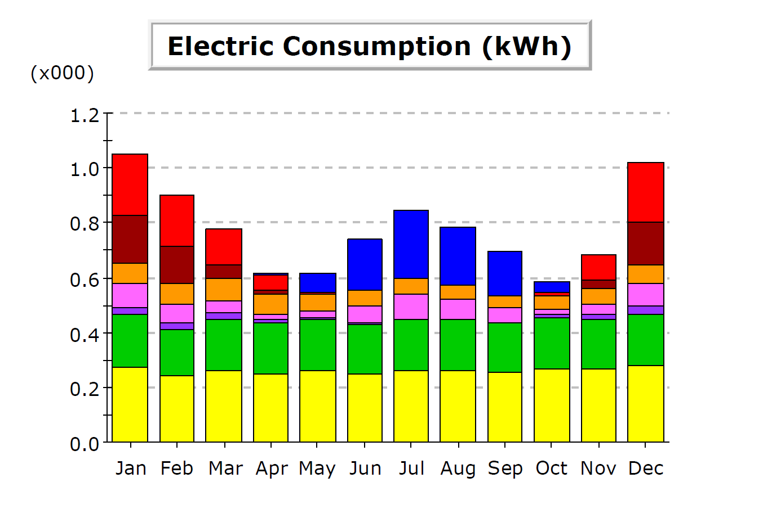
Expected Demand Model Results
Factors:
33% Percent Occupancy Rating
Lower Demand on HVAC
Conscientious User Inputs
Yearly Electrical Consumption
9,320 kWh

Slide 9
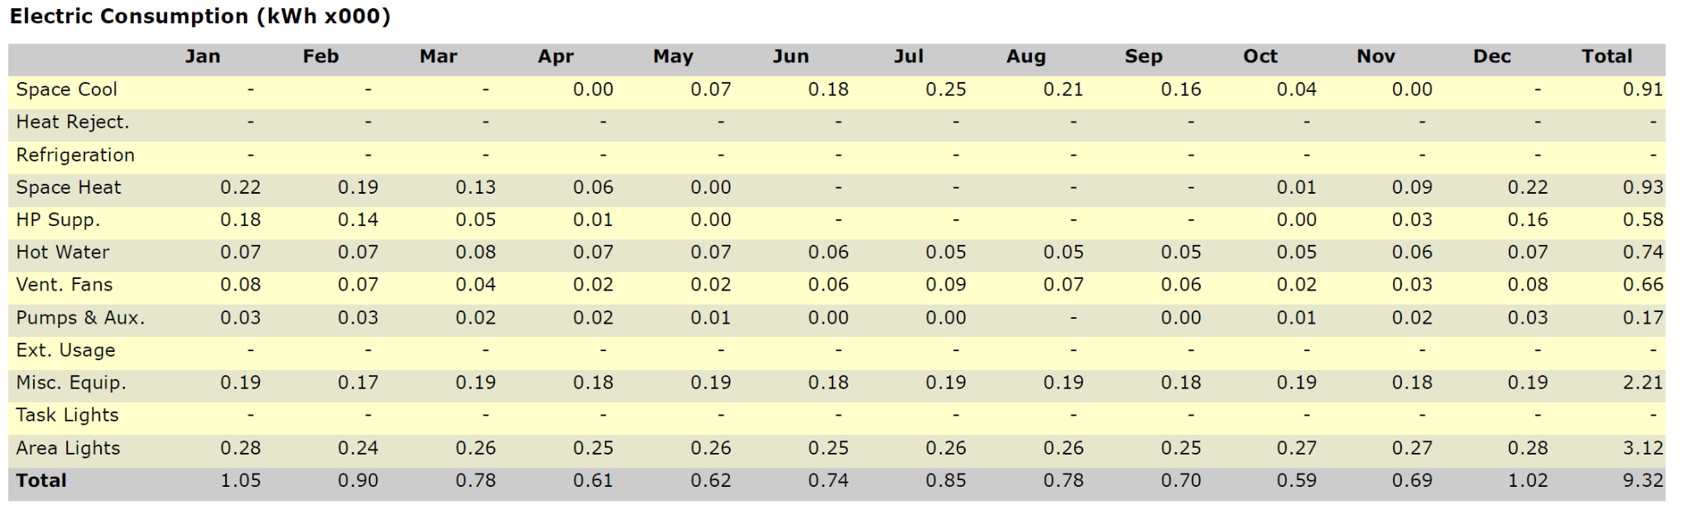
Expected Demand Model Results (In-Depth)

Slide 10
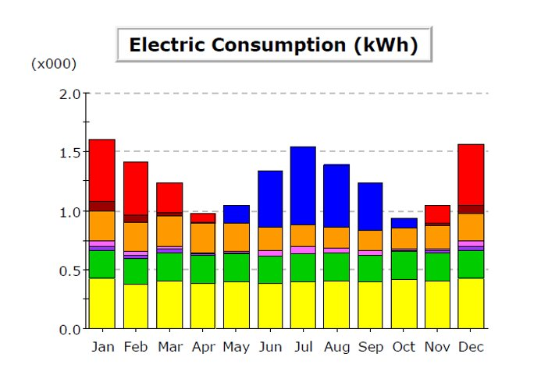
High Demand Model Results
Factors:
80% Percent Occupancy Rating
Heavy Demand on HVAC
Heavy Demand on Lighting
Yearly Electrical Consumption
15,230 kWh

Slide 11
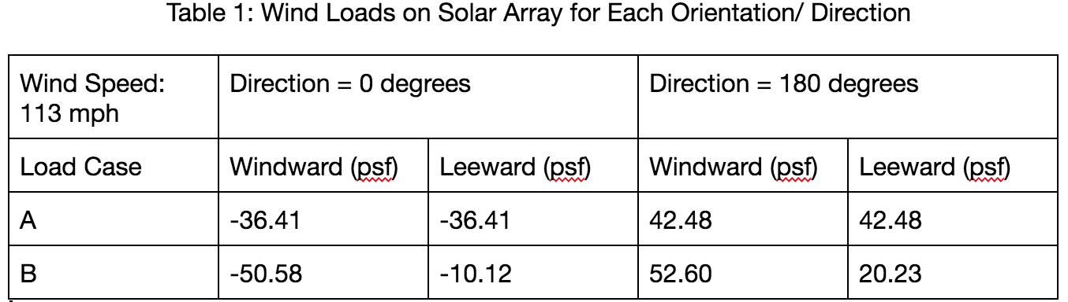
Structural Analysis: Prerequisite Calculations
Full report completed with calculations for wind loads, dead loads, and snow loads

Slide 12
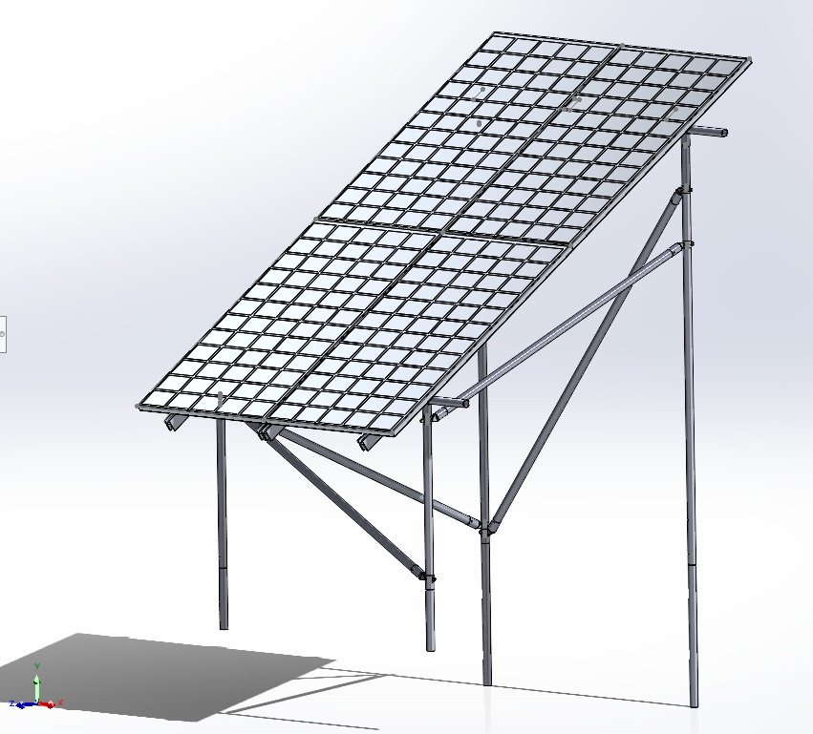
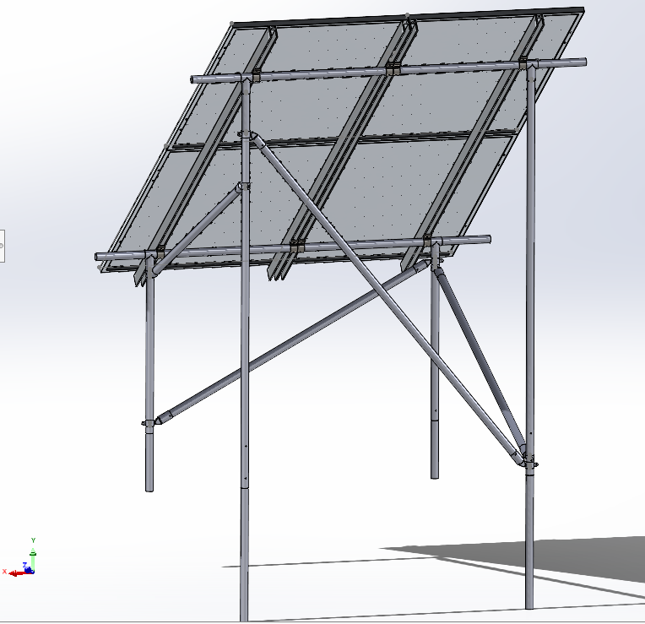
Structural Analysis: FEA Structure Assembly

Slide 13
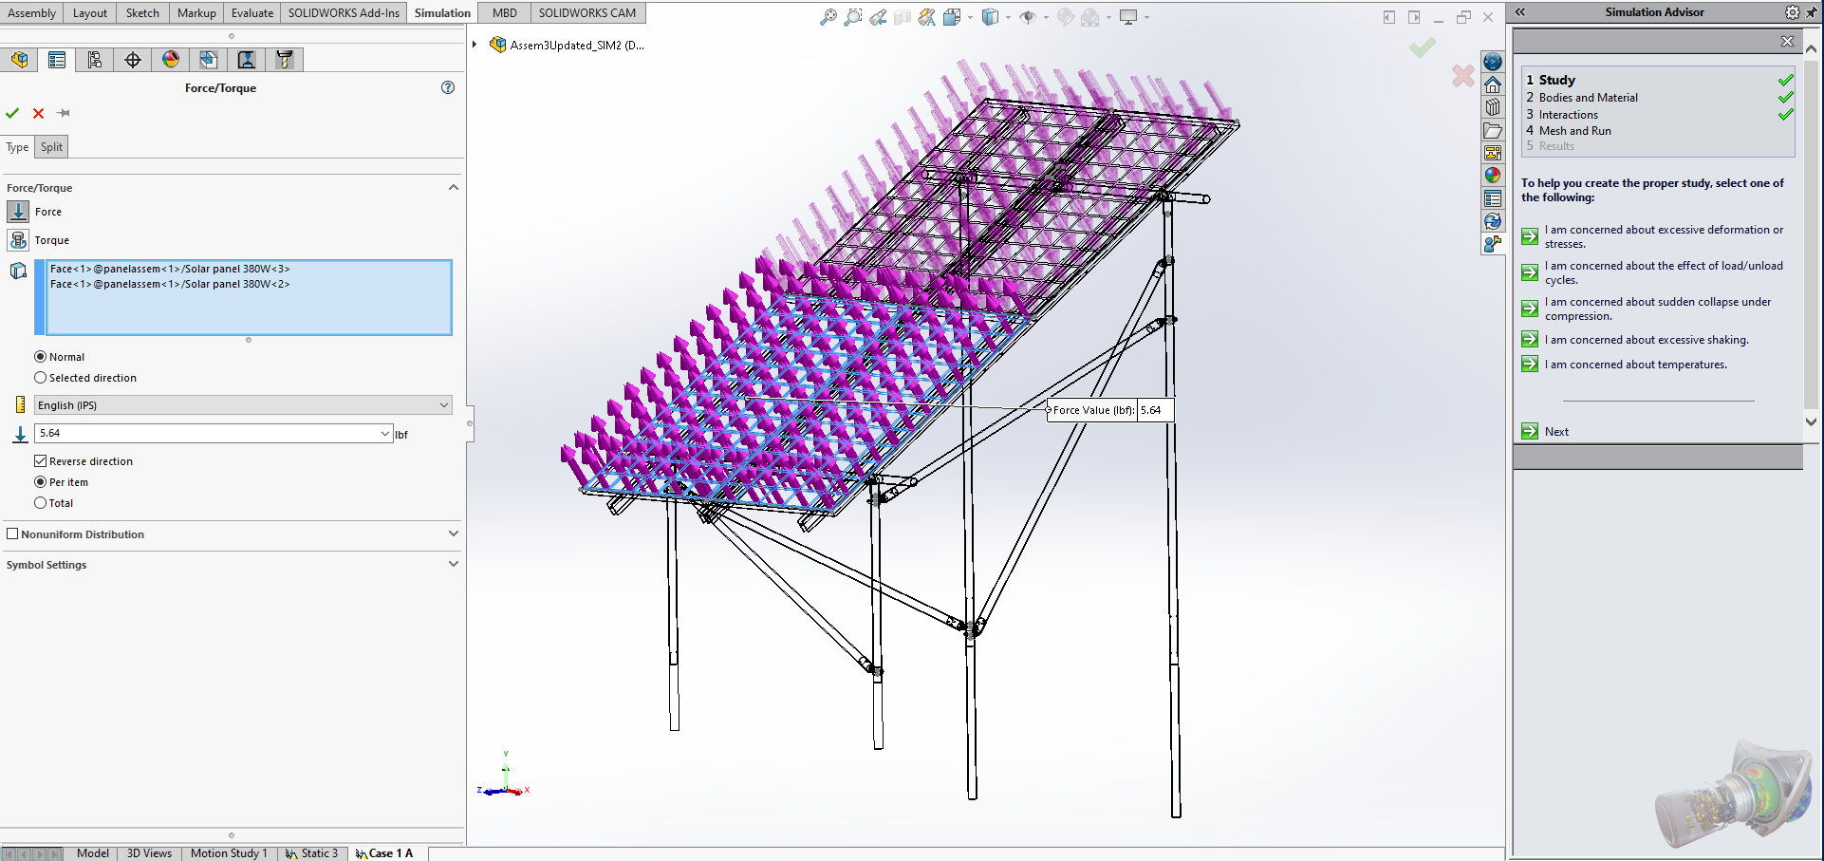
Structural Analysis: Finite Element Analysis Process
- All Integral Components Added
- Meshing Adjusted
- Load Distribution Adjusted
- Leeward and Windward
- Load Components integrated
- Load Case A:
Perpendicular to leading edge
-Load Case B: Parallel to leading edge

Slide 14
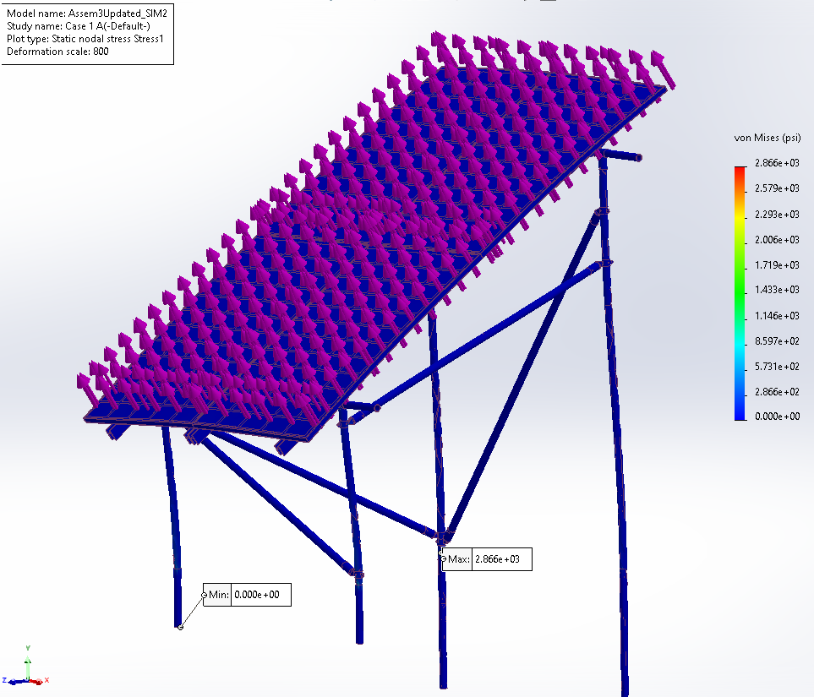

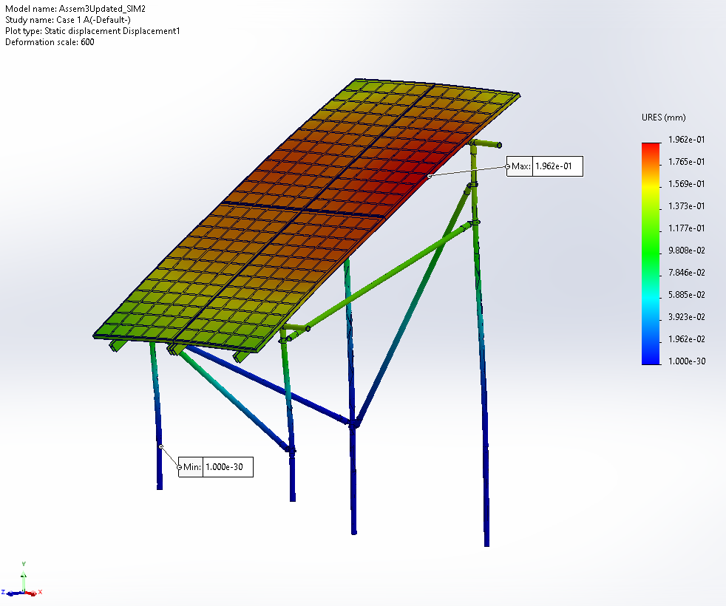
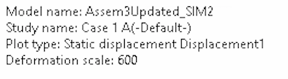
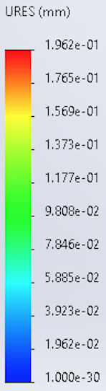
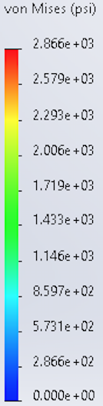
FEA Results: Load Case 1A
Total Windward PSF: -27.11
Total Leeward PSF: -27.11

Slide 15
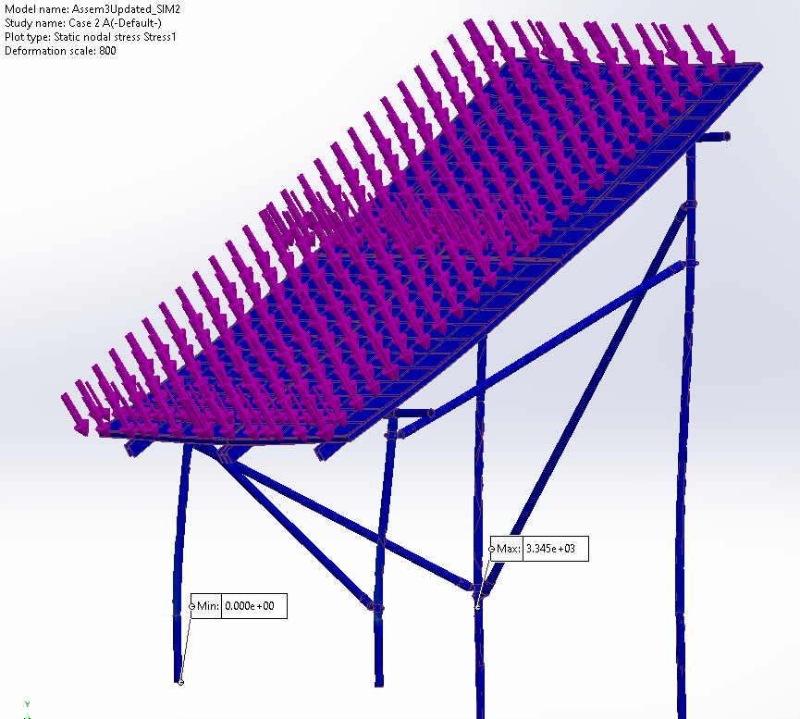
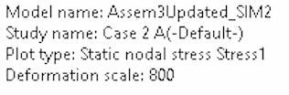
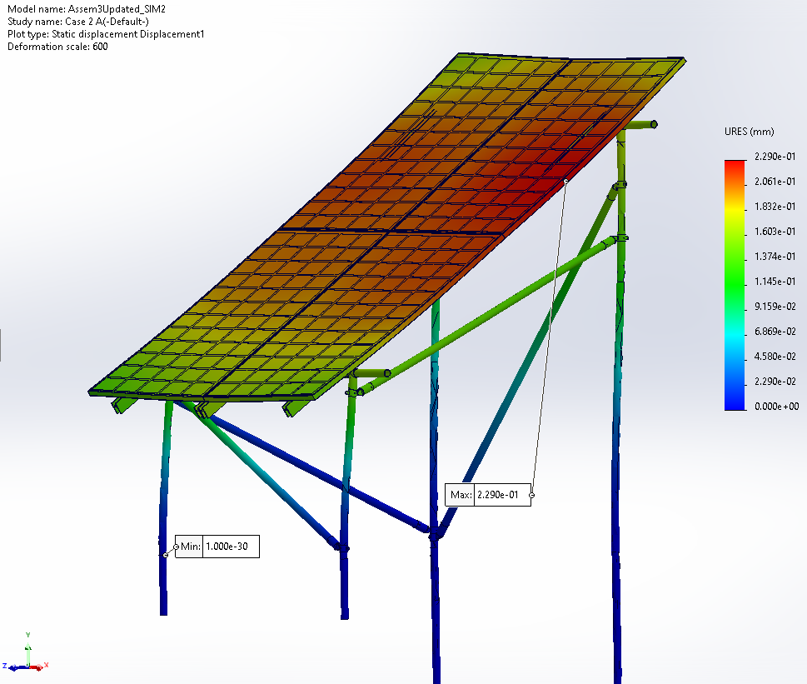
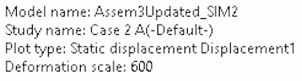
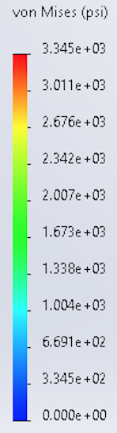
FEA Results: Load Case 2A
Total Windward PSF: 51.78 Total Leeward PSF: 51.78

Slide 16
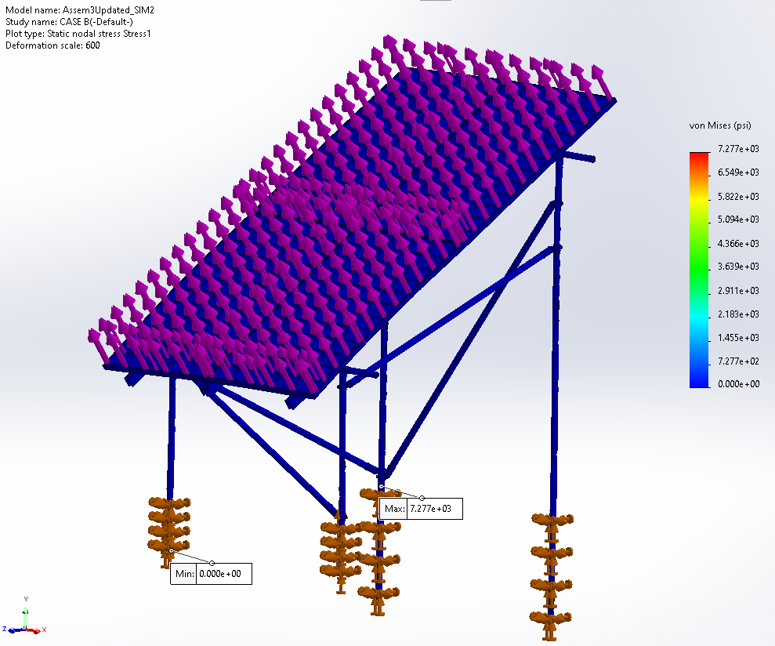
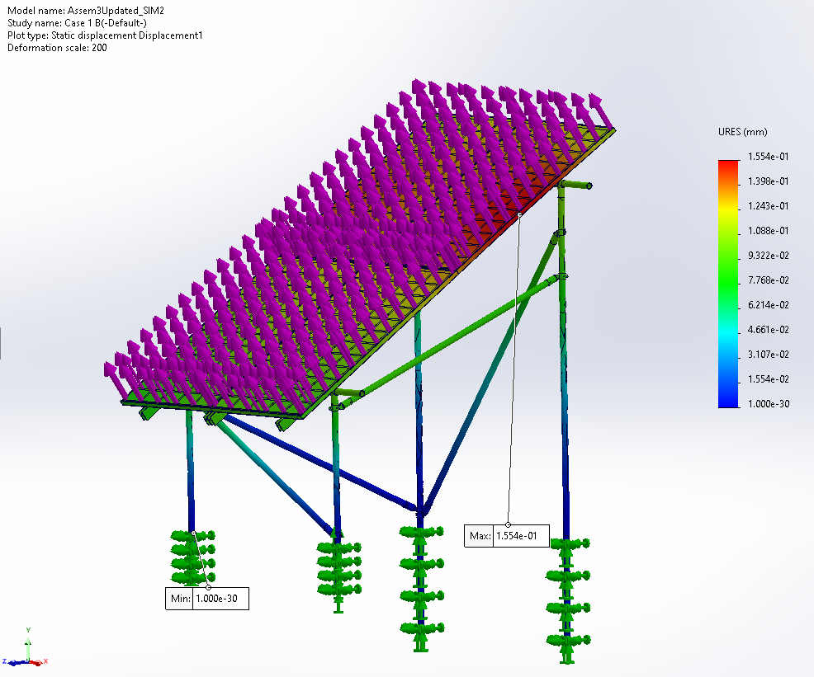
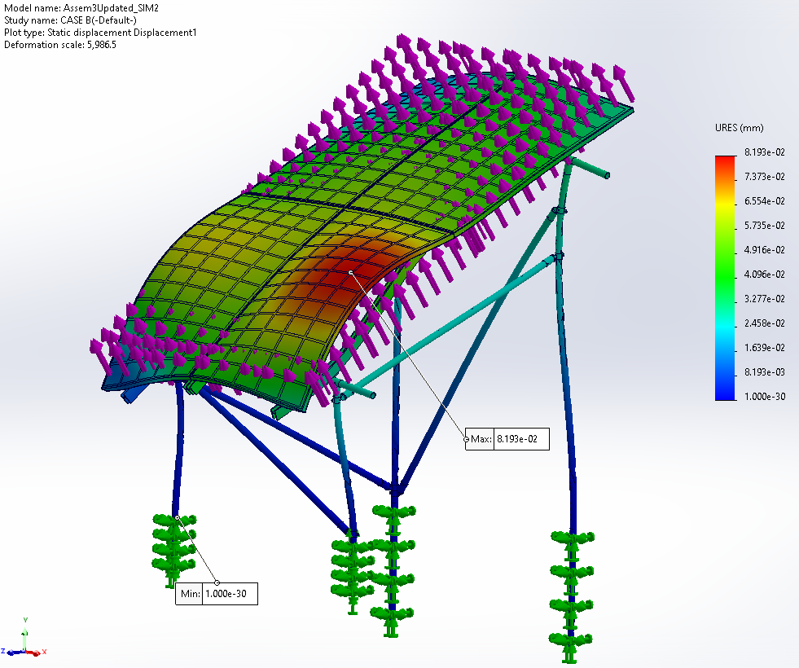
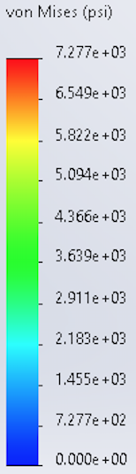
FEA Results: Load Case 1B
Total Windward PSF: -41.28 Total Leeward PSF: .82

Slide 17
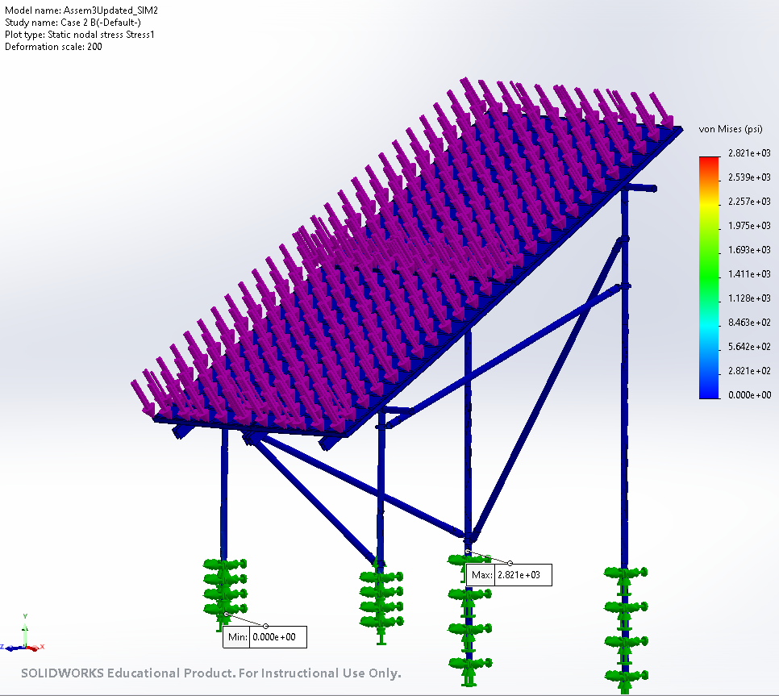
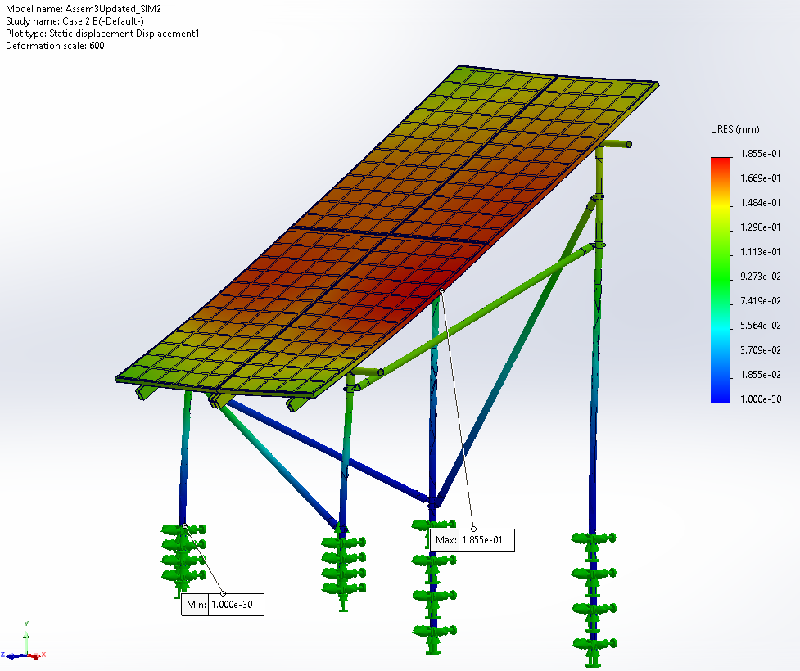
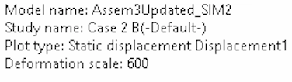
FEA Results: Load Case 2B
Total Windward PSF: 61.9 Total Leeward PSF: 29.53

Slide 18
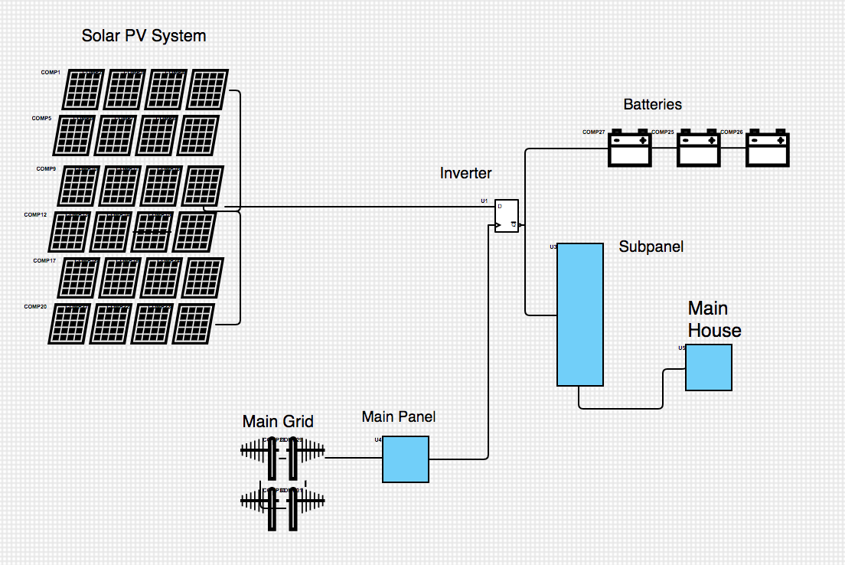
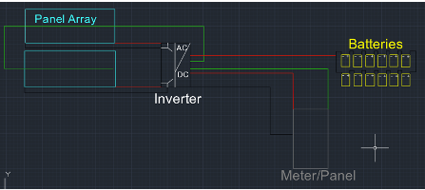
Electrical Diagram
Electrical Diagram 2.0 (33% build)
Nicholis Santana
9/28/23
Renewable Energy

Slide 19
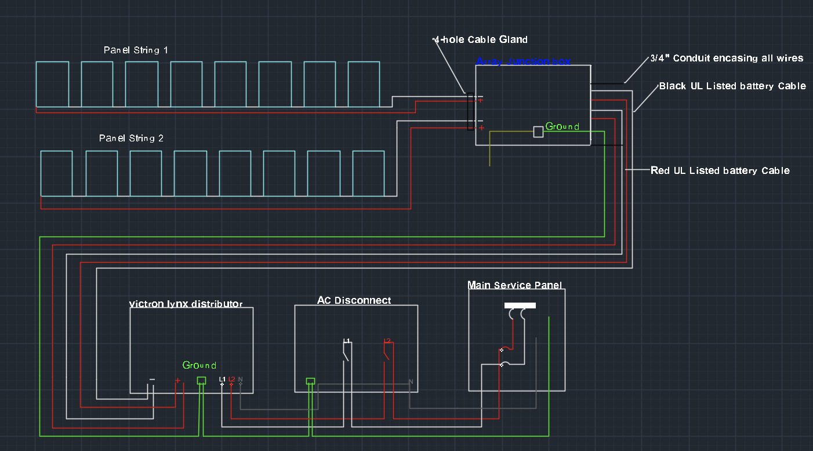
Electrical Diagram 4.0 (100% build)

Slide 20
Permitting Process
Basic site plan provided showing property lines, easements, locations of structures and equipment
Layout of array configuration and placement of equipment and modules with dimensioned access and vegetative clearance
Electrical 3-line drawing
Marking and signage
Provide cut sheets for all PV equipment and mounting systems
Equipment type, listing, testing agency approvals
Plans must show compliance with Building, Electrical and Fire Code
Permanent labels and signage
Elevation view showing maximum height of PV installation above ground

Slide 21
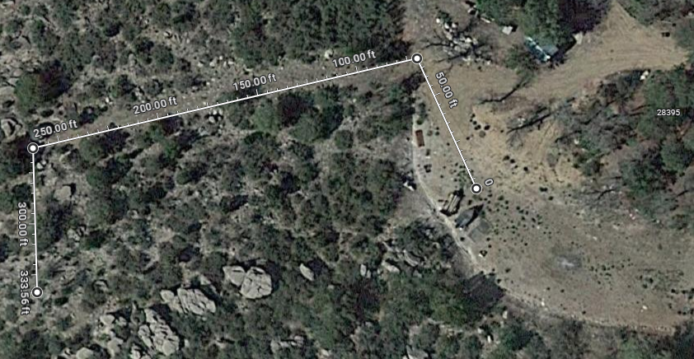
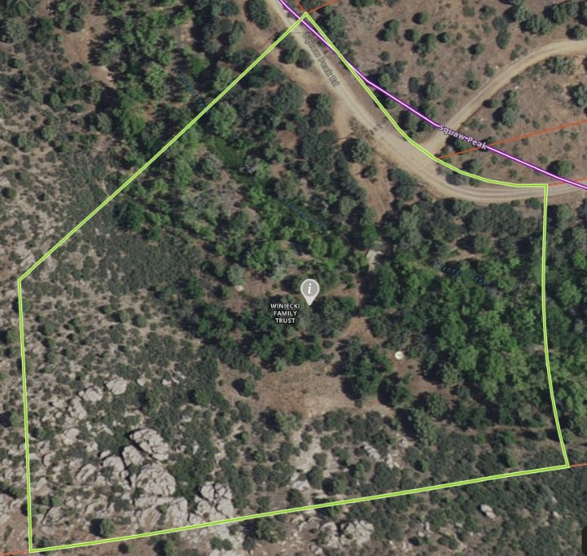
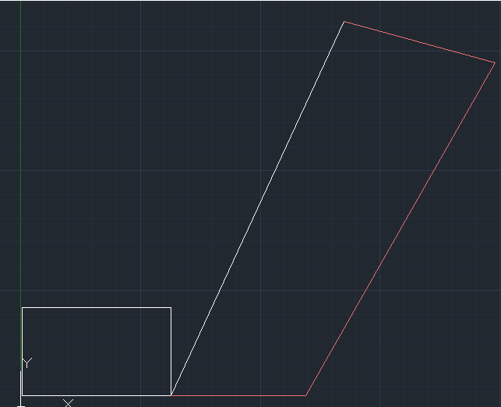
Permitting Site
Property lines
Sight layout
Electrical configuration

Slide 22
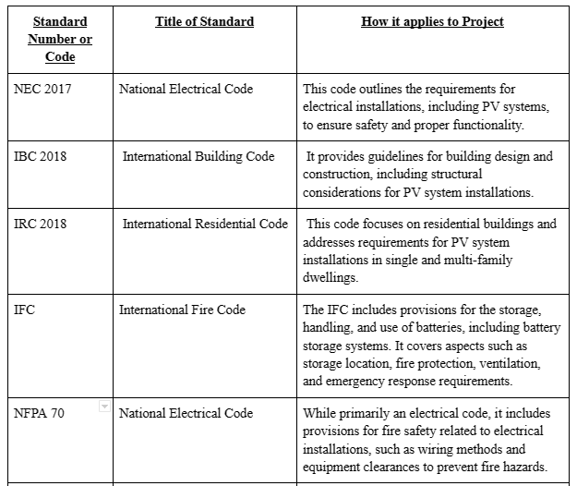
Permitting Codes
Building Codes
Electrical Codes
Fire Codes

Slide 23
Additional Codes
NEC Electrical | 705.12 | Load Side Connections/Alternate Power Source
 | 690.14 | Photovoltaic Disconnect Engraved Label
 | 690.7 | Maximum Voltage between any two conductors
 | 690.54 | Interactive System Point of Interconnection
 | 690.35 | Ungrounded Photovoltaic Power Systems

Slide 24
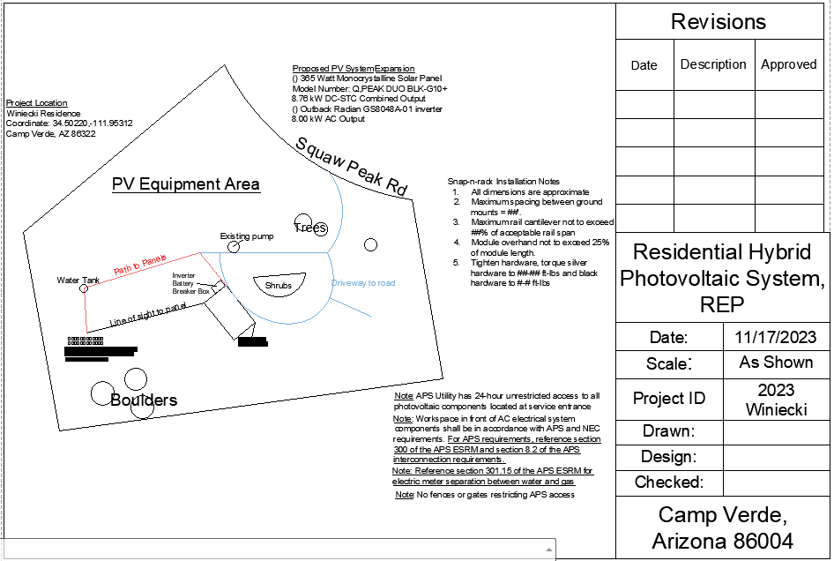
Site Permit

Slide 25
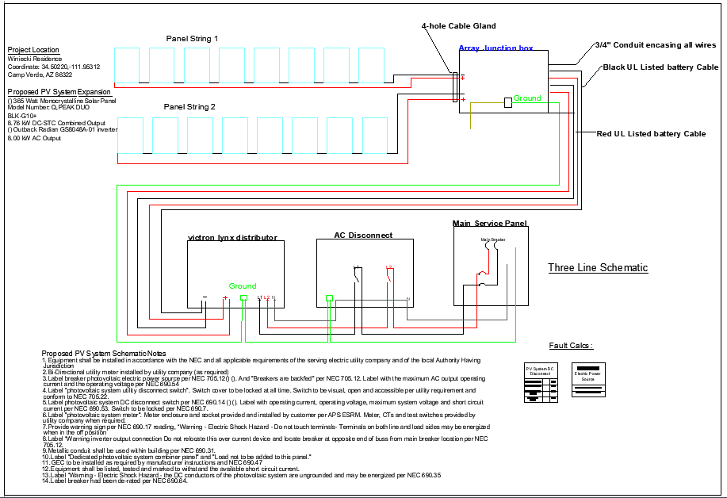
Electrical Diagram Permit

Slide 26
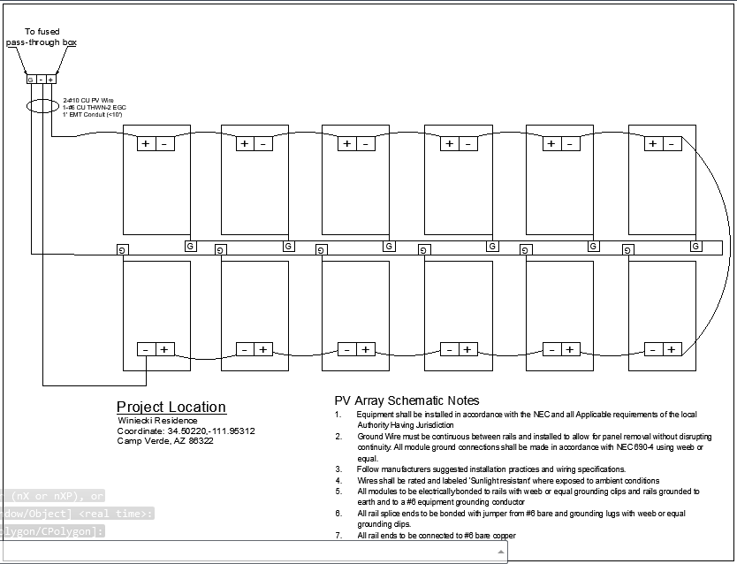
Panel Permit

Slide 27
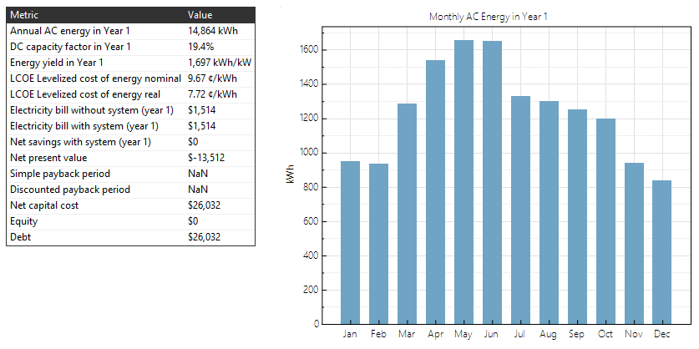
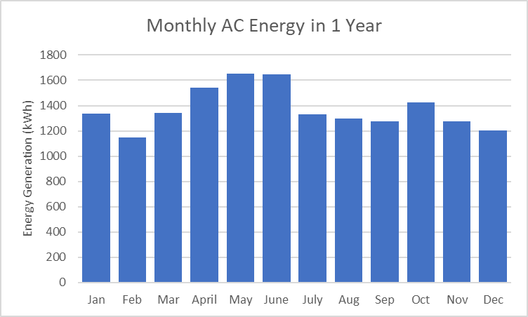
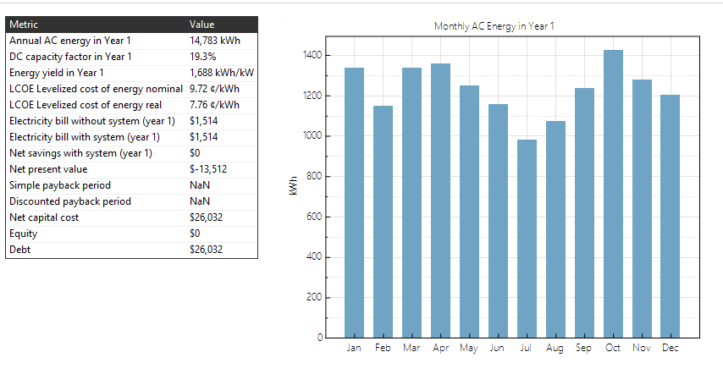
System Advisory Module (SAM)
11 Degrees at 14804 kWh
Optimized 11 and 50 degree with 16474kWh
50 Degrees at 14788 kWh

Slide 28
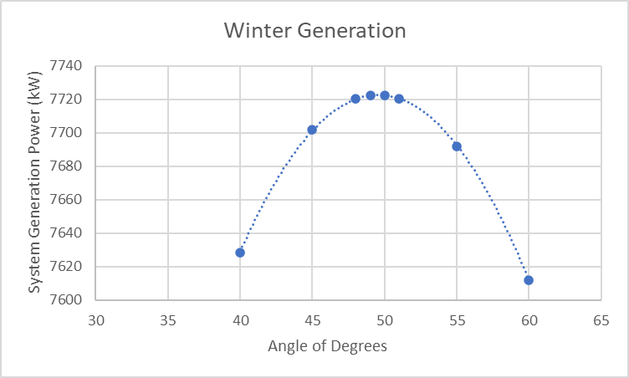
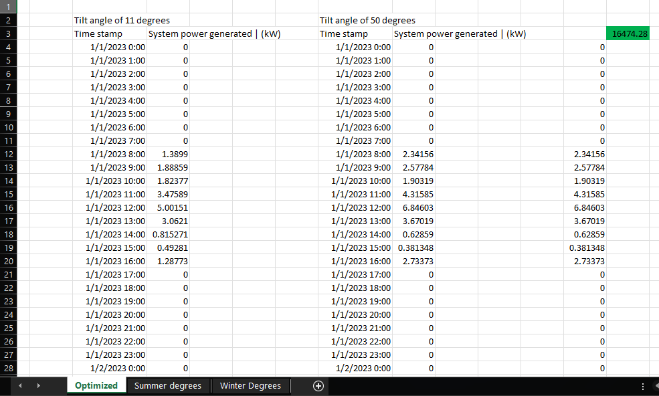
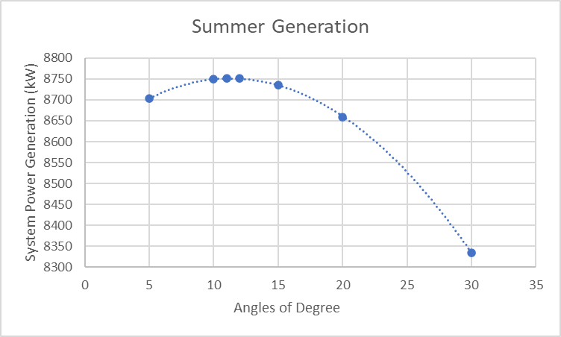
SAM Optimization
Issac Granados
Renewable Energy

Slide 29
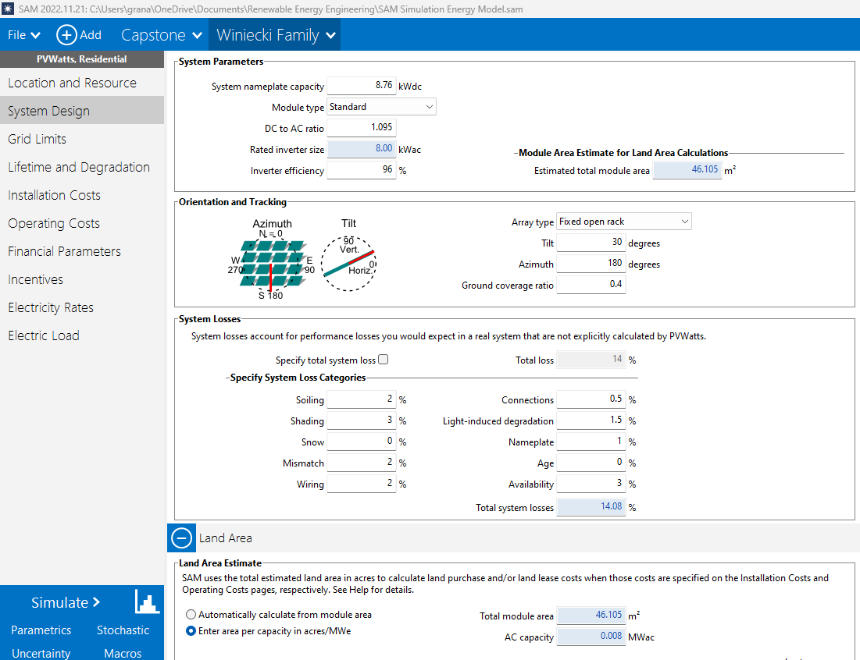
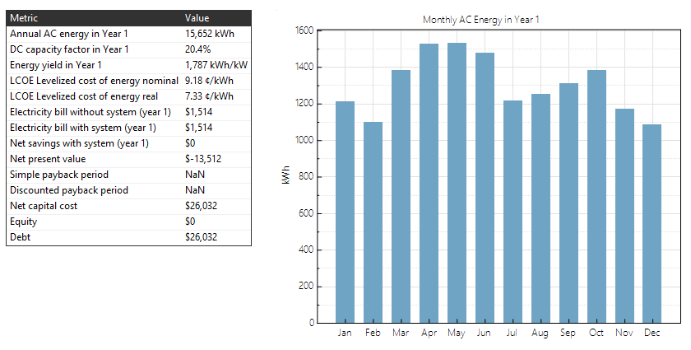
SAM - Fixed Operation
30 Degree Fixed Angle Generation
Issac Granados
Renewable Energy

Slide 30
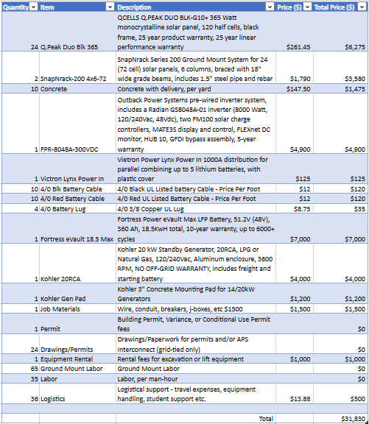
Projected Bill of Materials

Slide 31
Design Testing
Phase 1 Goal : Verify and Prove efficiency calculations | Phase 2 Goal: Gain experience and prove functionality
2 Individual Tests: Angle vs Output (Irradiance Testing) Panel Heat vs Output (Temperature Testing) | Stress Testing Utilize and Test existing hardware in Renewable Energy Lab Gain Hands-on experience

Slide 32
Phase 1: Irradiance Testing
Goal: Determine a relationship between tilt/ azimuth and power output
Power may be determined by collecting voltage, irradiance, and current data
Hypothesis: Optimizing tilt and azimuth panel angles WILL maximize power output
Increased solar irradiation will result in higher power generation from panels
To maximize irradiation, panels must be normal to light source
Theory: Power (w) = Irradiance (w/m^2) * Surface Area (m^2) * Efficiency
Testing:
Fixed Azimuth, Varying Tilt Angle
Voltage, Current, and Irradiance data collected and plotted
Fixed Tilt Angle, Varying Azimuth
Voltage, Current, and Irradiance data collected and plotted

Slide 33
Testing Equipment
Licor LI-200 Pyranometer
Used to measure solar irradiance, outputs voltage signal
Breadboard and 150 Ohm Resistor
Allows calibrated pyranometer data collection
DL 3021 Electronic Load
Allows variable resistive load; voltage and current data collection
Computer
Allows data recording
Fluke 45 Digital Multimeter
Used to collect voltage data for Pyranometer
Solar Panels
Testing medium
Cell Phone
Allows azimuth and angle measurement
Stand
Consistently retains tilt angle and azimuth

Slide 34
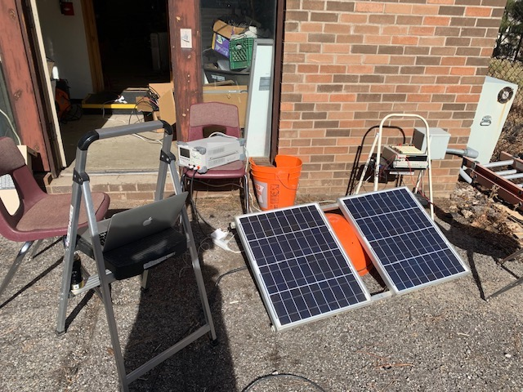
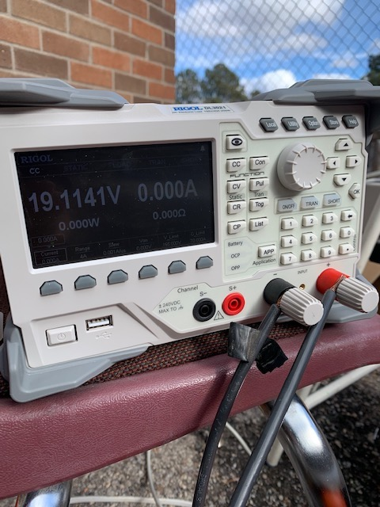
Phase 1 Testing: Varying Panel Tilt Angle and Azimuth

Slide 35
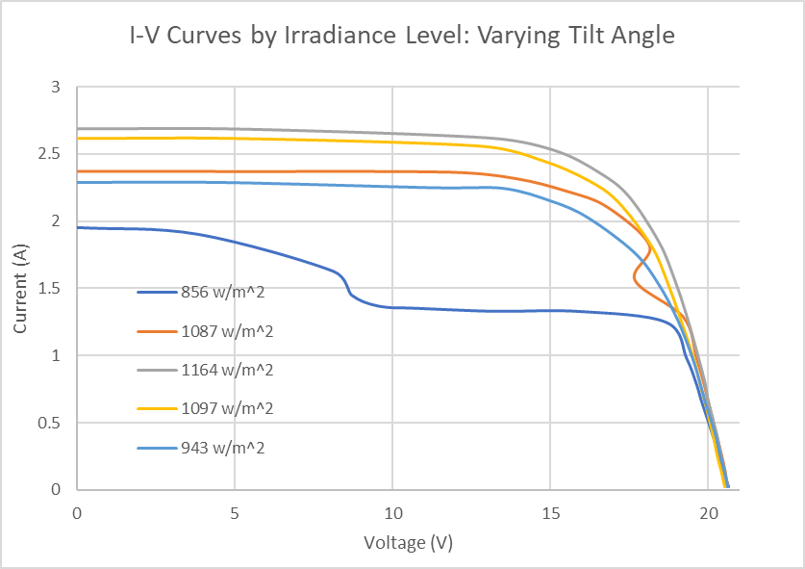
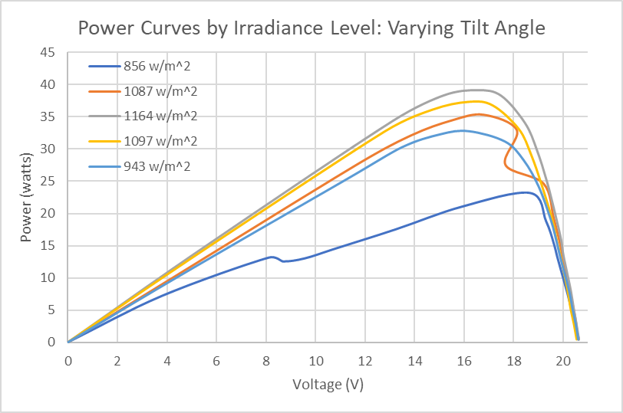
Phase 1: I-V and Power Curves

Slide 36
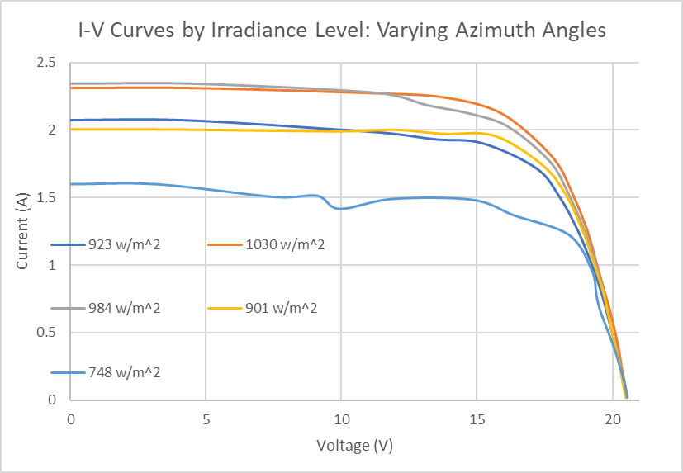



Phase 1: I-V Curves for Varying Azimuth

Slide 37


Phase 1: Max Possible Power

Slide 38


Calculated Data

Slide 39
Phase 1 Test 2 : Effects of Panel Temperature
Ground Mounted vs Roof Mounted Design
Ground Mounted systems have advantage of additional passive cooling but introduce an additional cost to the system.
Camp Verde Avg Annual High Temps 60 - 100 ℉
Camp Verde Avg Annual Low Temps 40 - 70 ℉
Goal: How does heat effect Panel output and what are efficiency gains with a ground mounted system, if any?

Slide 40
Effects of Panel Temperature Testing Methodology
Use two identical 20 W panels from the renewable energy lab
Mount one panel on existing roof structure, and the other on the ground
Track temperature and output of both panels simultaneously
30 minute test, results tabulated every minute.
Compile results to show Temp Delta for each panel and analyze results
Find Voc Data
Interpolate IV Curve to find Power Decay

Slide 41


Phase 1 : Effects of Panel Temperature

Slide 42



Phase 1 : Effects of Panel Temperature

Slide 43

Roof Mount Raw Data
T Start : 50.4 ℉
T Max : 111.1 ℉
Avg Roof Temperature : 109 ℉
Equalization Time : ~ 25 min

Slide 44

Ground Mount Raw Data
T Start : 52.4 ℉
T Max : 77.5 ℉
Equalization Time : ~ 20 min

Slide 45


Phase 1 : Effects of Panel Temperature
 | Ground Mount Panel | Roof Mount Panel
T Initial | 52.4 ℉ | 50.4 ℉
T Max | 77.5 ℉ | 111.1 ℉
Time to T Max | 18 Min | 25 Min
T Delta (Initial vs Max) | 25.1 ℉ | 60.7 ℉
T Delta (Max vs Air) | 4.5 ℉ | 38.1 ℉

Slide 46


Phase 1 : Effects of Panel Temperature
 | Ground Mount Panel | Roof Mount Panel
T Delta °K (Initial vs Max) | 13.9 °K | 33.7 °K
Voc Delta | -1.55 Volts | -3.73 Volts
Isc Delta | - 3 mAmps | -1 mAmp
Voc Coefficient | -.51%/°K | -.51%/°K

Slide 47

Phase 1 : Effects of Panel Temperature
Voc (Volts) | 21.8
Isc (mAmps) | 968
Max Power (Watts) | 13.12
Voltage @ Max Power | 16.0
Current @ Max Power | 0.82
Panel Degradation : 1.38 % / Year

Slide 48
Phase 2: Application and Experience
Renewable Energy Lab Solar Panel Testing
Old array deconstructed
New solar panels installed, wired, and tested successfully
Inverter is receiving enough power to test functionality
Connected Inverter to grid power
GridZero Application
Special Inverter setting which utilizes hybrid solar PV with no grid feedback

Slide 49


Phase 2 Testing Photos
Existing Array
(No Output)
Updated Array
(20 V 100 A Output)

Slide 50



Phase 2 Testing Photos
Inverter System
System Monitor
Battery Bank

Slide 51



Phase 2 Testing Photos
20 Amp Breaker
Updated Solar Production Values ( ~ .6 kw)
Simulated Power Draw Source

Slide 52
Phase 2 Testing Results
“Hands - on” experience
Greater knowledge of system components and application
Understanding of inverter importance as a system controller
PV system competency
Validation of system settings with controlled environment
Simulates system install and set-up

Slide 53
Project Conclusion
An optimized 8.8 kW, 24-panel ground-mounted hybrid photovoltaic system for residential use in Camp Verde, Arizona
Impact, benefits, and economic feasibility of utilizing a PV system at the residential scale is displayed
Final design enables implementation of the PV system

Slide 54

Questions?
Check out our website for student contact info, detailed reports, calculations and more!

